Slide 1
Nosql Databases
The principles underlying Nosql databases and Distributed systems in general

Slide 2
Structure of today’s talk
History of NoSql
Classification of NoSql systems
Consensus and Consistency
Techniques underlying NoSql systems
Deep dives on specific NoSql Stores
Considerations in using NoSql systems and a decision tree
Looking forward - tech trends influencing Nosql landscape
Case studies
‹#›

Slide 3
Key motivation for rise of NoSql
Object - relational impedance mismatch
Rise of Big(ger?) data
Web 2.0 and increased access of services leading to increased scale
Rise of Cloud and 5 Nines availability
Increased availability of open source solutions

Slide 4
Timeline of the early NoSql years
Neo4J started in 2000
Memcached started in 2003
CouchDB starts in 2005 (inspired by Lotus notes)
Google Bigtable research paper released in 2006
Amazon Dynamo research paper released in 2007
Facebook opensources Cassandra in 2008
Redis, Riak, HBase (a Bigtable clone on Hadoop ecosystem) start in 2009
Eric Evans of Rackspace introduces the term NoSql
‹#›

Slide 5
About 70 percent of operations were of the key-value kind, where only a primary key was used and a single row would be returned. About 20 percent would return a set of rows, but still operate on only a single table.
- Werner Vogels, A Decade of Dynamo
‹#›

Slide 6
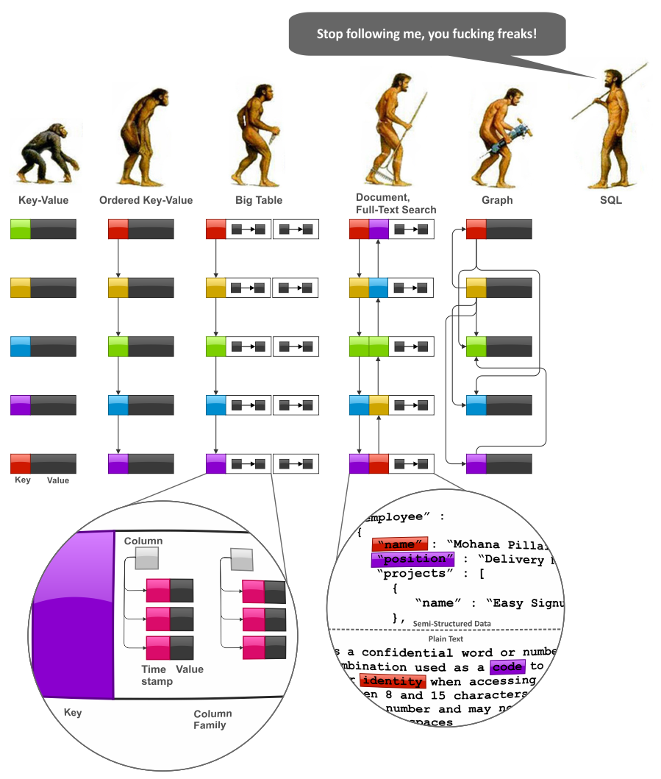
Classification based on data models
Key - Value stores
Document stores
Wide column or column family stores
Graph databases
Columnar databases
Time series databases

Slide 7
Consistency and Consensus
‹#›

Slide 8
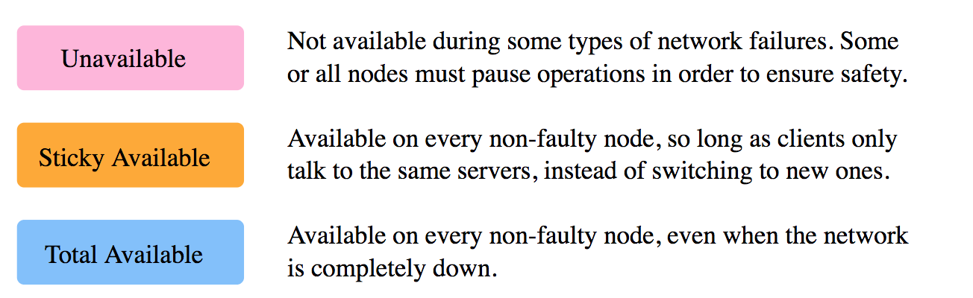
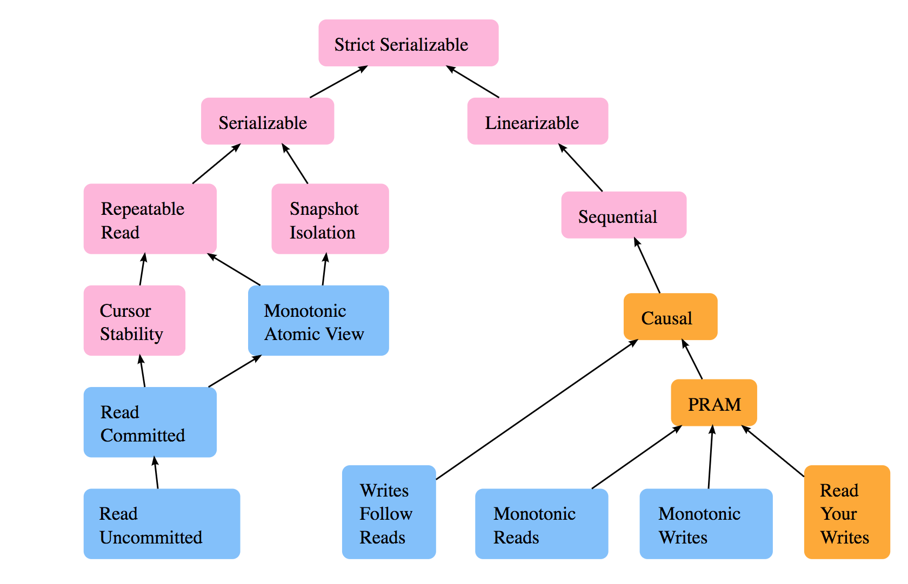
Consistency models
Notes:
http://www.vldb.org/pvldb/vol7/p181-bailis.pdf
https://jepsen.io/consistency

Slide 9
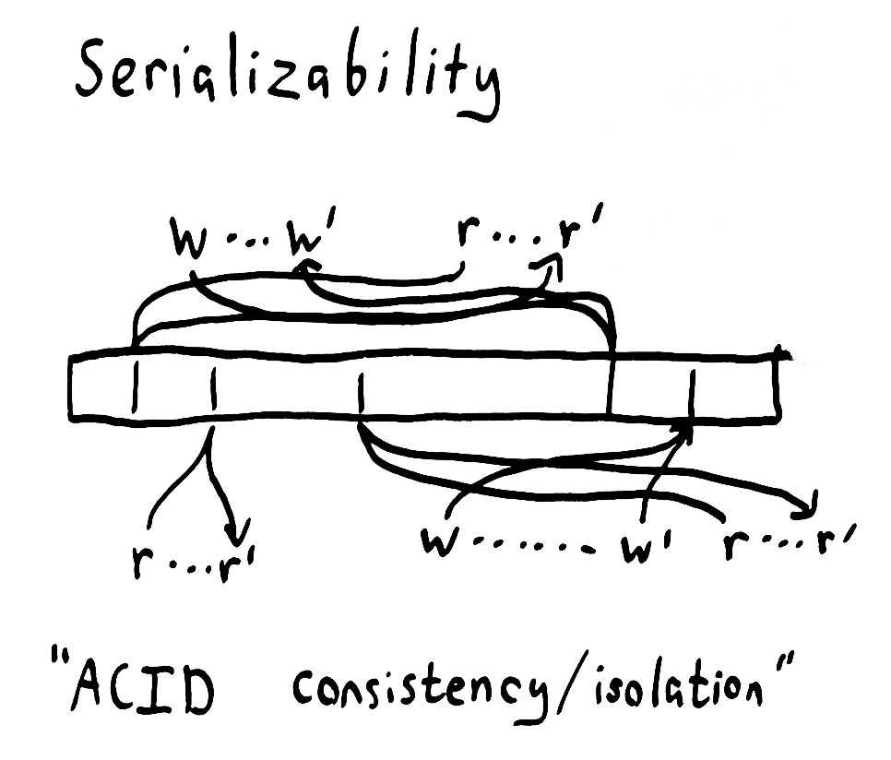
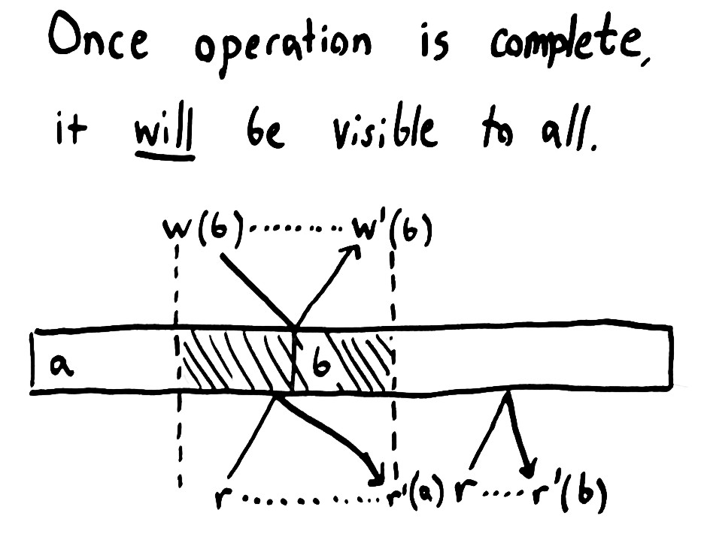
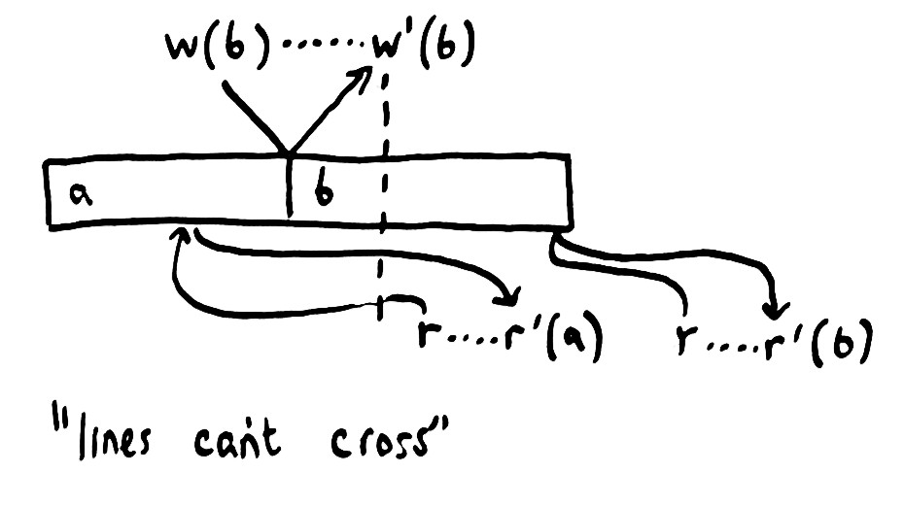
Linearizable consistency model
Serializable consistency model
sequential
consistency
model
Notes:
https://aphyr.com/posts/313-strong-consistency-models
Sequential consistency model example: tweets and posts visible in order but not at the same time to all readers

Slide 10
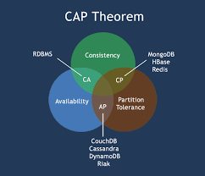
CAP Theorem
Presented by Eric Brewer in 2000 and later proved by Gilbert and Lynch
AP systems: Non failing node that has lost contact with other nodes continues to accept requests
CP systems: Non failing node that has lost contact with other nodes stops responding to requests
AC systems: systems which are available and consistent but fail under n/w partitions. E.g single node systems

Slide 11
PACELC
CAP describes tradeoffs between Consistency, Availability and Partition tolerance
Mainly relevant in the case of network partitions
Introduced by Daniel Abadi from Yale university in 2010
PACELC describes tradeoffs between Latency and Consistency
Relevant under normal conditions
Partitioning-Availability-Consistency-Else-Latency-Consistency
Cassandra, Riak, CosmosDB are by default PA / EL
BigTable, HBase, VoltDB are PC / EC

Slide 12
Consensus
Key building block of distributed systems
Consensus algorithms
Paxos, Raft - quorum based algorithms
Implementation mechanics of consensus in nosql systems
Implement consensus algorithms themselves - Cassandra, elastic search
Use another system to provide consensus - Zookeeper, etcd, Chubby
Zookeeper, EtcD, Chubby

Slide 13
Useful Consistency properties
Read-Write consistency properties
Eventual consistency
Read after write consistency
Read after Read consistency
Write-Write consistency
Atomic writes using last write wins - Cassandra
Conflict prevention
Distributed locking / Paxos
Master - Slave
RDBMS, HBase, Mongo DB
Conflict detection
Maintain versions and let client resolve conflict
Riak, Voldemort, CouchDB

Slide 14
R, W, N
N is number of replicas
W is the minimum number of nodes where writes have to be successfully replicated
R is minimum number of nodes where reads must be successfully executed
W < N, high write availability
R < N, high read availability
W+R > N, fully consistent system
R = N/2 + 1 = 3
W = N/2 = 2

Slide 15
Key NoSql Techniques
Sharding
Replication
Storage management
Query processing

Slide 16
Sharding
‹#›

Slide 17
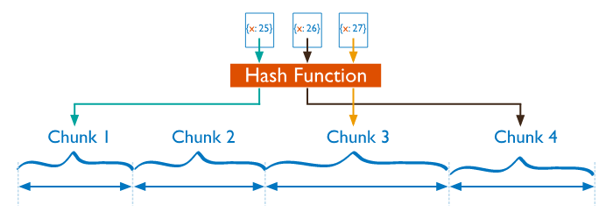
Hash Based partitioning
applies a hash function to some attribute that yields the partition number
serverid = hash(id)%servers
Very disruptive when new nodes are added or existing nodes are removed

Slide 18
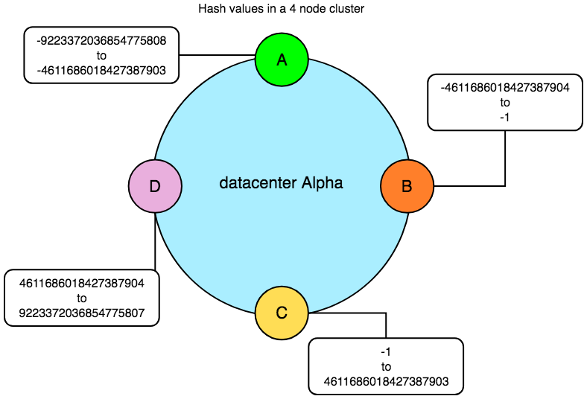
Consistent Hash Based partitioning
Allows for dynamic addition and removal of servers
Could lead to uneven distribution of data
Ignores variable performance of servers
Solutions
Assign nodes to multiple locations in ring space (Dynamo)
Dynamically move nodes in ring space (Cassandra)

Slide 19
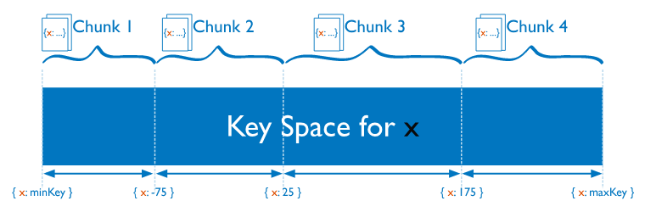
Range based partitioning
Data partitioned into ordered and contiguous value ranges
Allows for range queries
HBase, BigTable, Mongo, RethinkDB

Slide 20
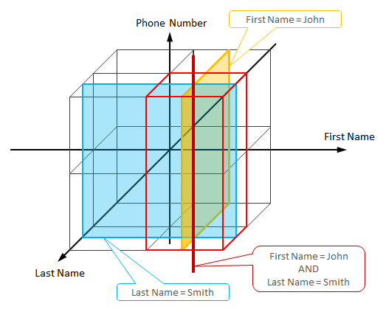
Multi attribute sharding
Consistent hashing good when querying by single key but not so good for querying by multiple attributes
This approach to data placement optimizes for number of nodes to be queried when querying by attributes
An example is HyperDex database

Slide 21
Replication
‹#›

Slide 22
Replication
Techniques
Writer coordinator
Reader coordinator
Synchronous writes
Async writes
Digest read
Old data
Synchronous Reads
Unavailable node
New data
Anti Entropy
Hinted handoff
Read one Write one
Read repair
Notes:
Source: https://highlyscalable.wordpress.com/2012/09/18/distributed-algorithms-in-nosql-databases/
When updates are propagated
Synchronous replication
Asynchronous replication
Where updates are propagated
Master - Slave
Multi - Master

Slide 23

Replication techniques
Any W where W > N/2
Any W where W > N/2
Read quorum Write quorum
Read all
Write quorum
Any R where W + R > N
Conflict detection
Conflict prevention
Read one Write all
Paxos / 2PC
Master Slave

Slide 24
Storage management
‹#›

Slide 25
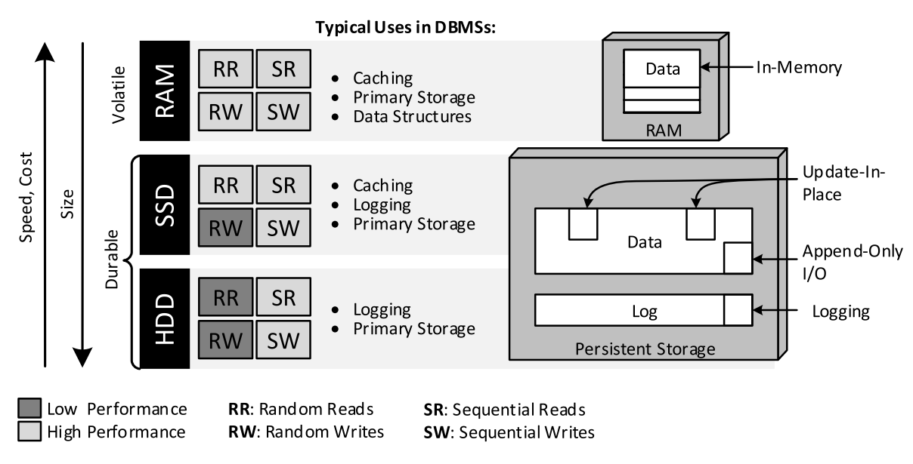
Storage pyramid
Sequential IO on logs to ensure durability in most nosql systems
In SSDs random writes are an order of magnitude worse than random reads.
Aerospike engineered to take advantage of this.
In HDDs both random reads and writes are slower than sequential access by 10-100 times
Many Nosql systems do in place update. E.g. MongoDb
Performance mitigated by logs and in memory caches.
In RAM random access is just as fast as sequential access
Notes:
Sequential IO on logs to ensure durability in most nosql systems
In SSDs random writes are an order of magnitude worse than random reads. Aerospike engineered to take advantage of this.
In HDDs both random reads and writes are slower than sequential access by 10-100 times

Slide 26
Query processing
‹#›

Slide 27
Query processing
Primary key based lookup
Available for both hash partitioning as well as range partitioning
Filter queries
Available for hash partitioning as scatter-gather or range partitioning based on choosing partitions based on filter predicates
Secondary indices to avoid full scans
Local secondary indices (per partition) or global secondary indices
Full text search as a special case of global secondary index
Immediately consistent secondary indices or eventually consistent secondary indices
DynamoDB is an example of eventually consistent secondary indices
Almost no support for joins - open research problem
Typical real-time analytical needs addressed using Lambda / Kappa architectures rather than in database

Slide 28
NoSql store deep dives
‹#›

Slide 29
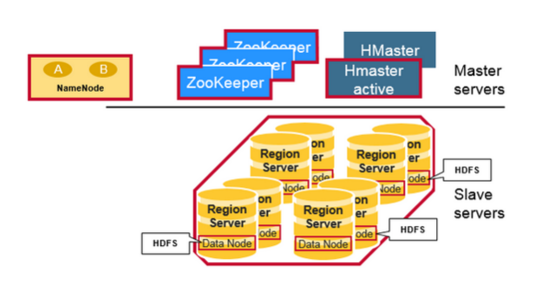
HBase
Consensus
Zookeeper
CAP
CP system
PACELC
PC-EC system
Partitioning
Range based partitioning. Regions have a start and end range and are assigned to a region server
Replication
Master slave, with single node for read-write
Async replication via HDFS
Query
No secondary indexes. Only primary index
Jepsen
No official Jepsen report.
Notes:
https://mapr.com/blog/in-depth-look-hbase-architecture/
It’s a CP system because by default writes and reads go to master
Region server components:
WAL, BlockCache, MemStore, HFile
Jepsen report by someone from the user community. Suggested consistency and availability with partition tolerance. But turns out clients were just retrying. When partitions failed for longer than timeout, availability reduced.

Slide 30
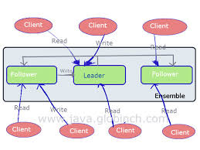
Zookeeper
Provides primitives for Distributed systems
Consensus
Implements ZAB protocol which is similar to Paxos
CAP
CP system offering Linearizable writes
PACELC
Can serve older data from replica. So EL system. To enforce EC, clients need to fire a sync request
Partitioning
All requests go through master
Replication
Write Requests to master also triggers replication to followers and returns when majority acknowledge.
Query
Jepsen
Test confirms that Zookeeper is linearizable
Notes:
Provides coordination services

Slide 31
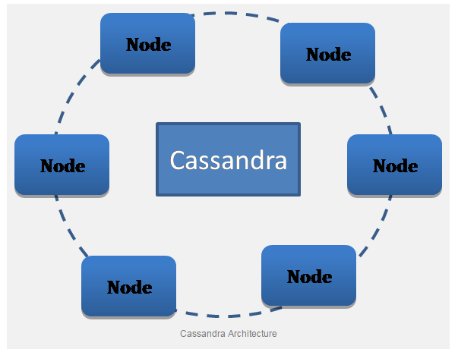
Cassandra
Consensus
Home grown solution. With 3.0 implements paxos for light weight transactions
CAP
AP system with configurable ways to make it CP system by setting number of R and W to be Quorum
Last write wins - does not use vector clocks
Use of immutability and conflict resolution on reads
PACELC
EL system by default but can make it EC by configuring R and W
Partitioning
Consistent hash partitioning
Replication
Tunable Quorums, Hinted handoffs and active anti entropy ensure all replicas eventually consistent
Query
Primary key based querying. Secondary indexes available. Query needs partition key along with secondary index key Cassandra uses local indexes.
Jepsen
Shows data loss due to last write wins - Cassandra uses wall clock
Notes:
Upon write, data is written to sequential commit log and then indexed and written to an in memory structure called mem table (like a write back cache)
Mem table written to disk to an immutable append only structure called SSTable. It is sorted.
No notion of master / slave. All copies of data are equal

Slide 32
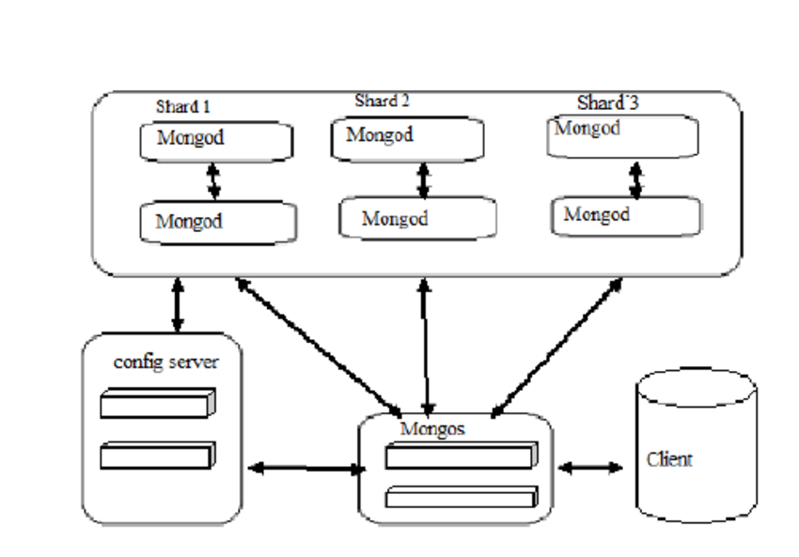
Mongo DB
Consensus
Home grown consensus
Since 3.2 inspired by Raft
Jepsen
Initially failed tests and got criticism. V0 depended on clocks for consensus
With 3.4 passed Jepsen tests under Majority write and Linearizable read concerns.
CAP :
PC or PA system depending on config
PACELC
EL or EC depending on config
Partitioning
Range based partitioning
Replication
Master-Slave with writes to master
Async replication in slaves (secondaries) by default
Using Write concern, can allow for “sync” replication
Query
Primary index as well as secondary indexes
Any number of secondary indexes including compound indexes

Slide 33
RethinkDB
Query
Supports secondary and compound indexes
Jepsen
Supports Linearizable consistency under majority reads and majority writes
Consensus
Uses Raft consensus
CAP
CP system with options for out of date reads
PACELC
EL if we accept out of date reads and EC by default
Partitioning
Range sharding using primary key. Optimised for range queries
Replication
Default is majority - i.e. synchronous replication to secondaries

Slide 34
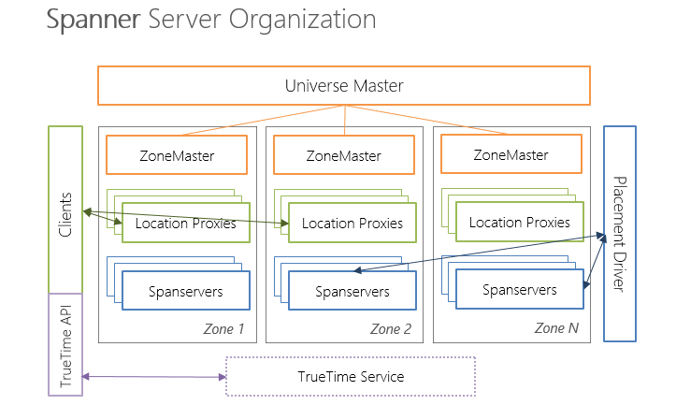
Spanner
Consensus
Each shard in Spanner is assigned to a paxos group
Consistency
Externally consistent reads and writes
All writes write to a paxos write-ahead log which is replicated
For blind writes and read-modify-writes, two phase locking ensures serializability within paxos group
From writes across paxos groups, we depend on two phase commits
True time
All transactions have time T
Snapshot isolation is basically transactions < T
Partitioning
Range sharding of databases
Parent - child relationships specified so that child rows co-located with associated parent
Replication
Shards distributed in a data centre and replicated across data centres
Querying
Uses a dialect of Sql called Standard Sql
Distributed query processing engine

Slide 35
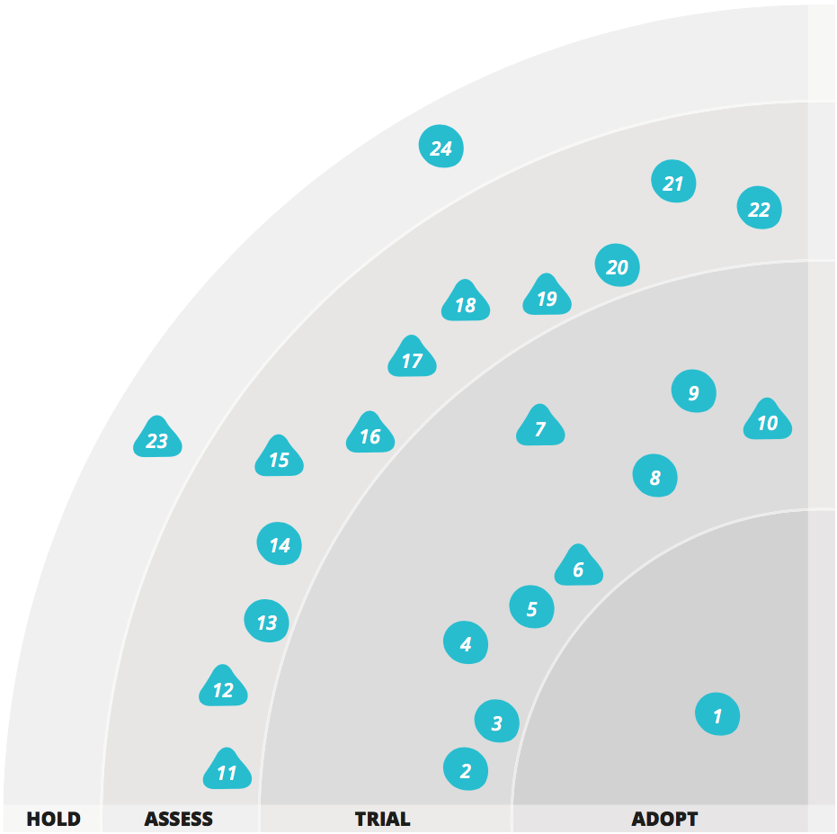
Challenges of NoSql
From Thoughtworks radar
Cassandra carefully
Big data envy
Operational complexity is significant
Nosql stores are not swiss army knives - they have specific use cases
Be careful with consistency guarantees made - look for Jepsen reports to validate claims

Slide 36
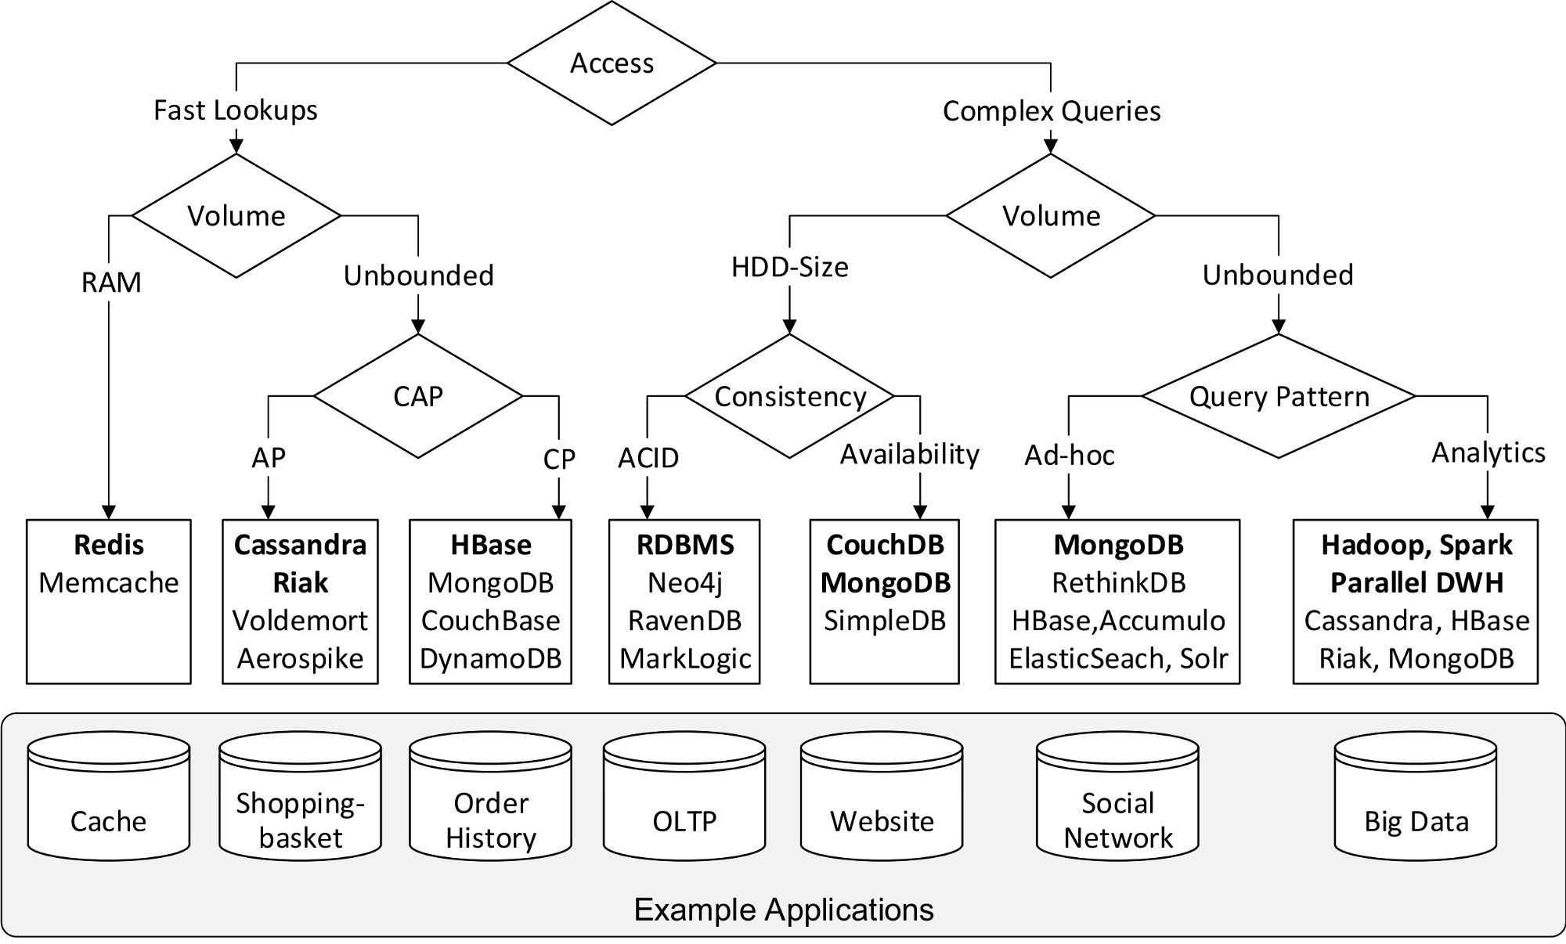
Decision tree for NoSql (from Baqend)

Slide 37
Tech trends influencing Nosql stores
‹#›

Slide 38
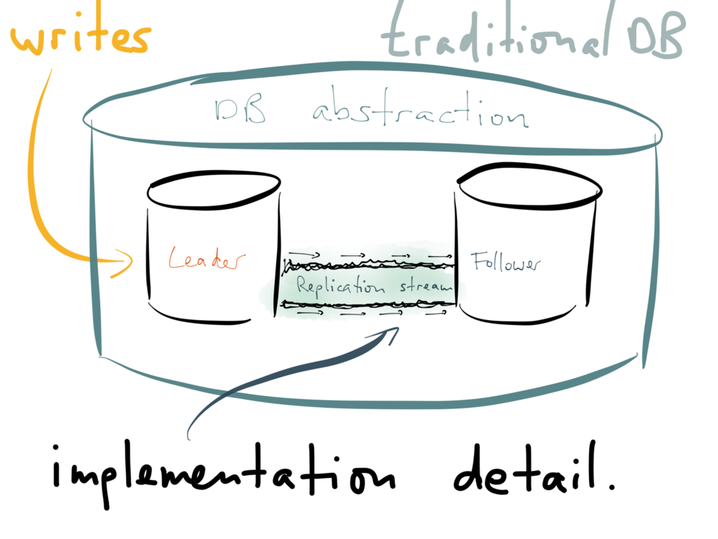
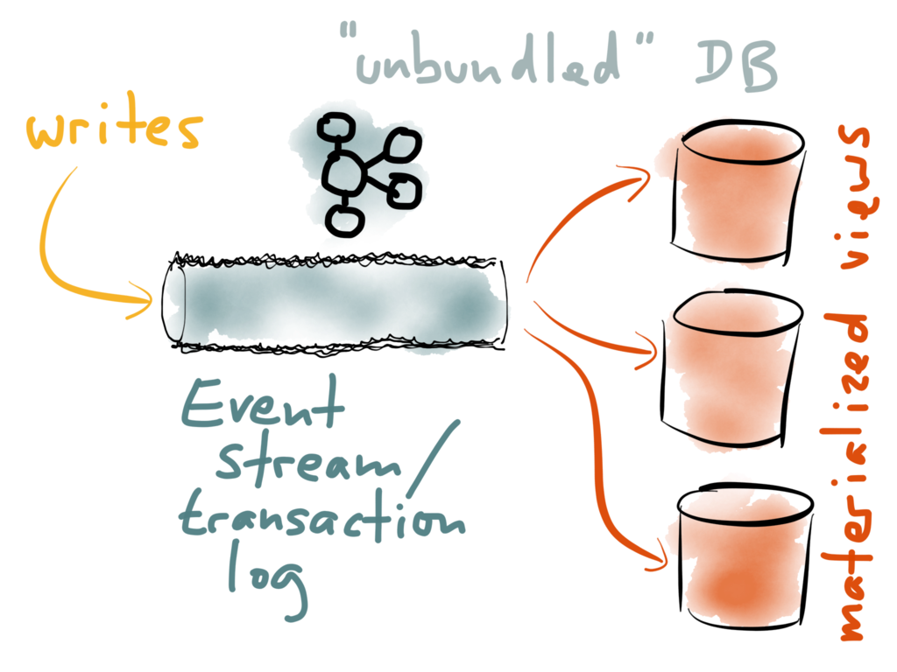
Streaming architectures
https://www.confluent.io/blog/turning-the-database-inside-out-with-apache-samza/

Slide 39

NewSql
New approaches
Volt DB, Spanner, CockroachDB, NuoDB
New Storage Engines
TokuDB, Scale DB
Transparent clustering
ScaleBase, DBShards

Slide 40
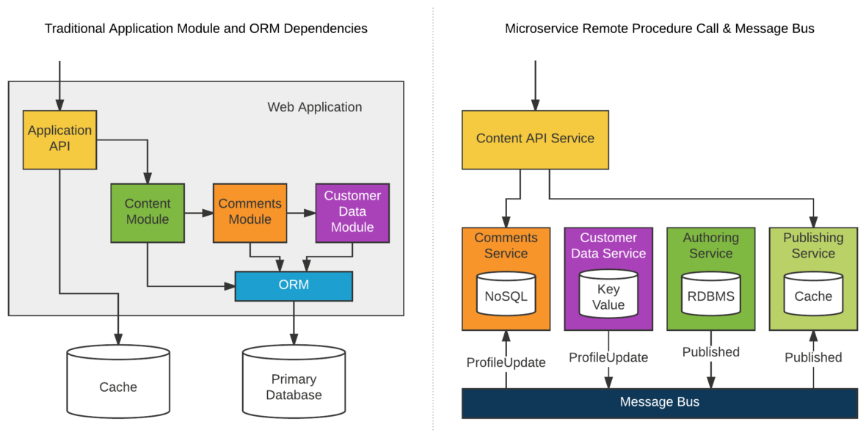
Micro services
But…. is the complexity paying off?
http://twintechs.com/migrating-to-microservice-architecture-1/

Slide 41
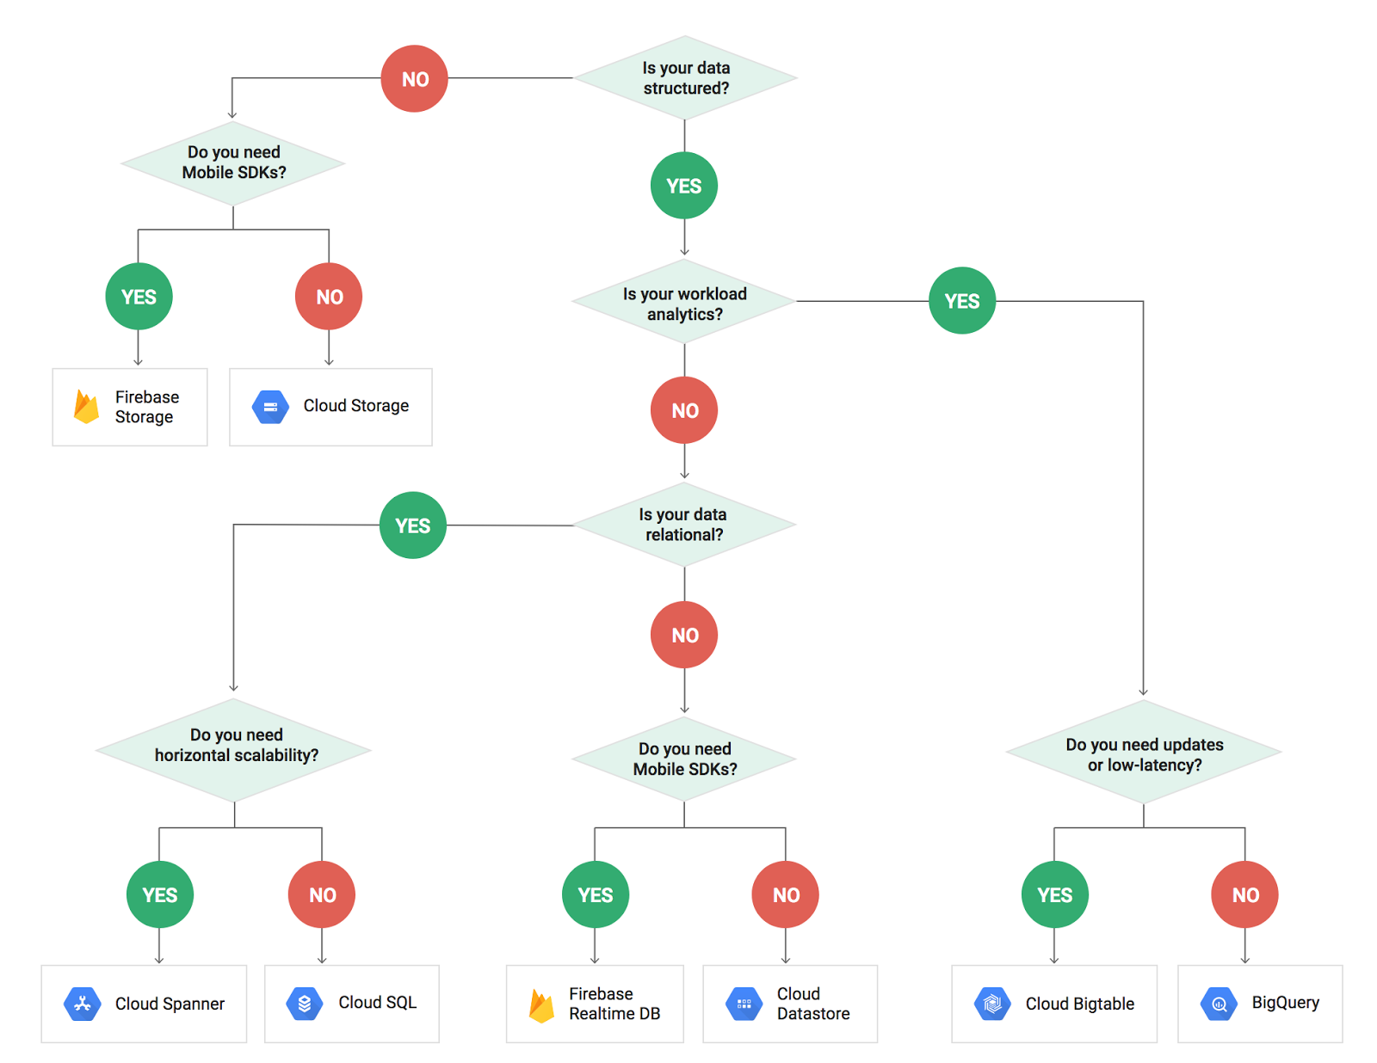
Cloud DBAAS
https://medium.com/google-cloud/this-week-in-google-cloud-a-db-storage-decision-tree-a-python-upgrade-a-new-ca-and-still-more-1a653c63d881

Slide 42
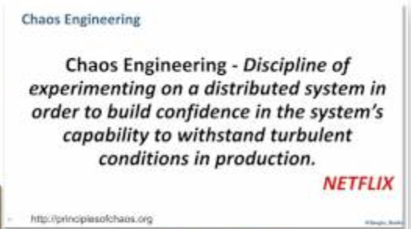

Chaos engineering

Slide 43
THANK YOU
Sudarshan Lakshminarasimhan

Slide 44
Casestudies
‹#›

Slide 45
Casestudy 1
As a business, I want to build a decision support system to help me set prices for all my products in every store
I would like my user interface to be a web grid which can handle hundreds of millions of records
I would like to be able to view various attributes of my product and location in each row of the grid - can go over a hundred attributes
I would like to be able to sort, search and filter over every column

Slide 46
Casestudy 2
I would like to bring in all the latest details of my products and stores every day and apply some rules to recalculate all prices
We can have over 100,000 products, over 10,000 stores and for each product-store combination we can have over 100 data points (competitor prices, historical prices for each week of the year, etc). We will use above data to determine the prices
What is the best store for me to store all the products, stores and data points so that I can bring in the data efficiently every day within 2 hours and also so I can efficiently read relevant data and calculate prices

Slide 47
Casestudy 3
I would like to use the UI to set prices for specific product - store combinations
This will use the same data points from previous case study to determine if this new price is valid
This needs to be highly responsive and complete in 1-2 seconds from the user’s perspective
Sometimes they can bulk edit thousands of prices which can take a few more seconds
Also multiple users will be working on this app to set prices.
What store can I use to read from during the rule evaluation?
What store should I use to ensure I don’t lose price updates due to users concurrently modifying prices?

